Slide 1


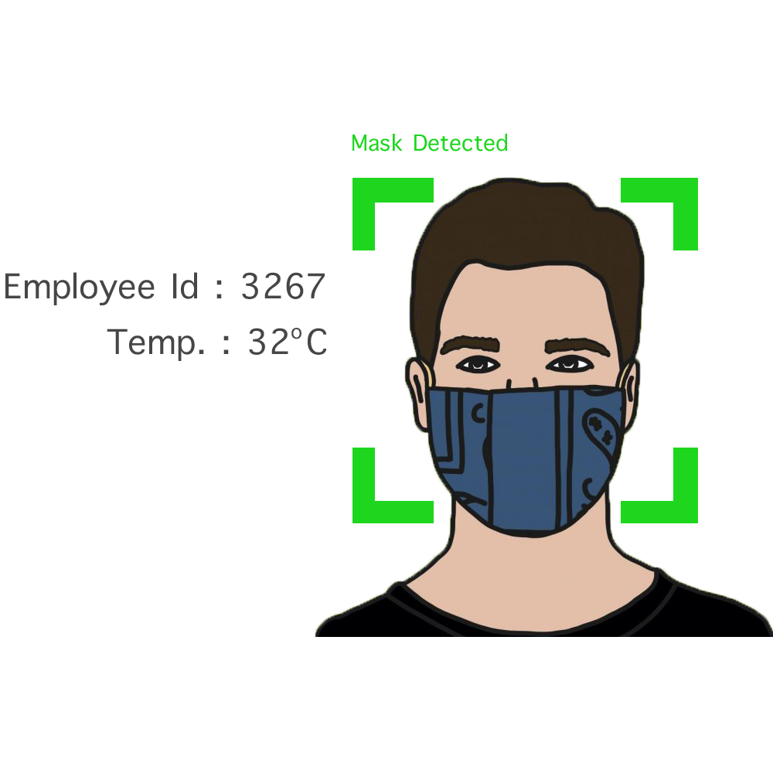
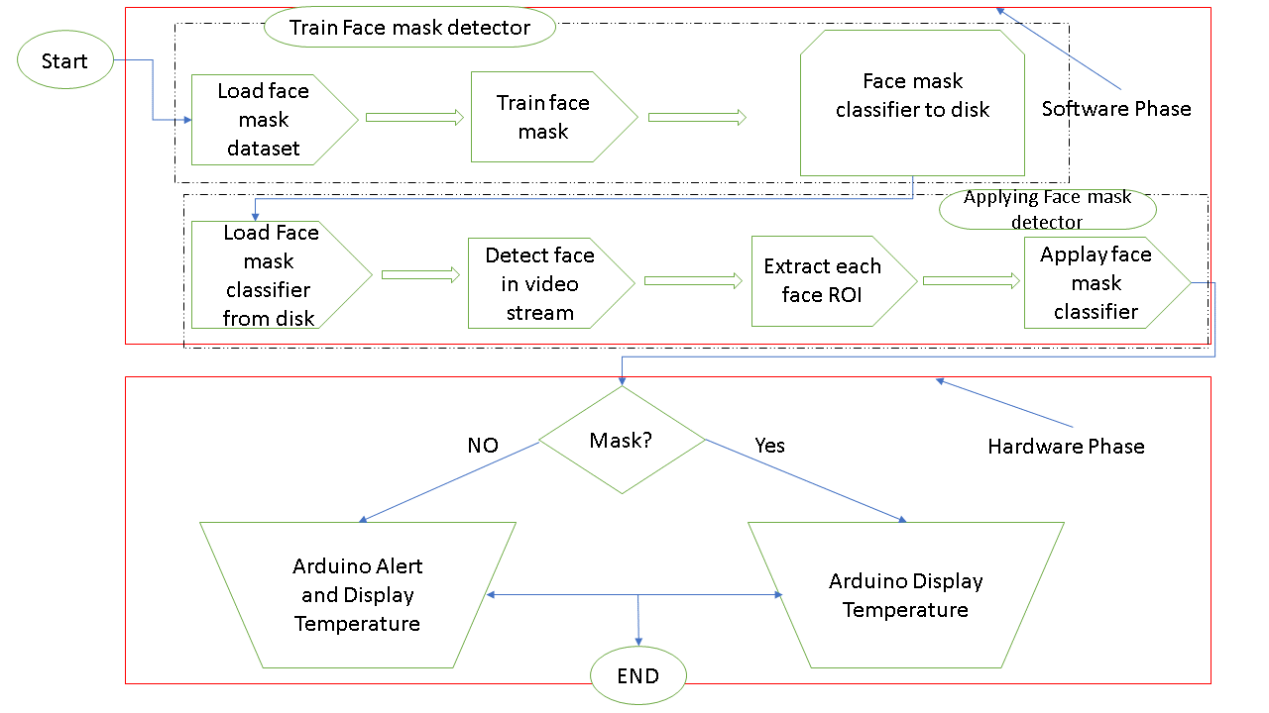
IEEE Engineering in Medicine & Biology Society
Lebanon Chapter
IEEE Lebanon Biomedical Student Competition LBSC 2021
Fighting Covid-19:Detection of facemask wearing
Ali Al Hadi Ayache – Dr.Rola Al Osta
1
Project Context
2
Project Objectives
After the arise of COVID-19, wearing a face mask is a critical defensive in times when social distancing is hard to maintain.
To design a system that can detect and recognize faces wearing a mask or not in real time.
To measure body temperature .
To simulate and obtain results using OpenCV with Python.
To implement the system on Arduino.
Measuring the body temperature is recommended as fever is considered as one criterion for screening. This project aims at detecting the presence of a medical face mask in real-life images, based on YOLO v4 model, as well as measuring the body temperature. If there is no mask, a buzzer will trigger a preventive alert.
Block Diagram
Methodology
3
4
This project basically consists of a camera placed in front of door.
The camera sends video frames to OpenCV running on a Windows PC.
OpenCV detects a face it will capture the image of the people entering public places, then the detected face image is sent to a the system to be compared (tested) whether the person wears a face mask or not using .
After the data processing, OpenCV will send the result to Arduino whether to measure a body temperature and alert if not masked.
5
Innovation
6
Main Challenges
Most important type of object detection in deep learning called YOLO, there are many versions but in this project we used (yolo-v4)for many reasons:
Can detect face coverings in a crowd, both in close-up footage and from a distance.
Yolo-v4 has obtained an AP value of 43.5 percent on the dataset along with a real-time speed of 65 FPS ,fastest and most accurate detectors in terms of both speed and accuracy, comparing with another versions, increased in AP 10% and FPS 12%.
The used laptop was not at the capacity to hand out this project because it was hard to manage this huge quantity of data.
The Module used to train the dataset was not enough and limited for the number of classes where I would be obliged to pay for more capacity to have a more accurate result.
© Islamic University of Lebanon – Werdanyeh Campus – August 2021

